Slide 1
Smart lock system.

Slide 2
Tools required
Arduino Uno circuit.
RIFD Sensor.
RIFD Tags/Card.
Relay Board.
Solenoid Lock.
Jumper cables.
9-12 Volt Battery.

Slide 3
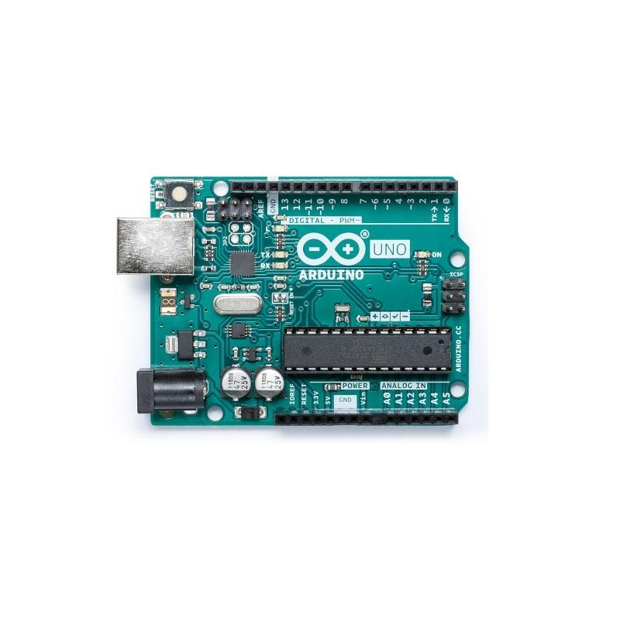
Arduino Uno Circuit.
Arduino Uno is a microcontroller board. It has 14V digital input, 6 analog inputs, a USB connection, a power jack, and a reset button. It contains everything needed to support the microcontroller; simply connect it to a computer with a USB cable or power it with a AC-to-DC adapter or battery to get started.

Slide 4
RIFD Sensor.
An RFID Sensor (Radio Frequency Identification Reader) is a device used to gather information from an RFID tag, which is used to track individual objects.
It is a wireless identification technology that uses radio waves to transfer data from the card tag to an RFID reader and identify the object presence.
Just like the bar code technology, RFID is used to identify objects, persons, by reading the card tag.

Slide 5
RIFD Tags/Card.
RFID tags are a type of tracking system that uses smart barcodes in order to identify items.
These radio waves transmit data from the tag to a reader, which then transmits the information to an RFID computer program.

Slide 6
Relay Board.
Relay boards are computer boards with an array of relays and switches. They have input and output terminals and are designed to control the voltage supply. Relay boards provide independently programmable, real-time control for each of several onboard relay channels.

Slide 7
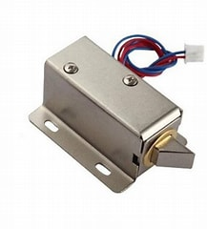
Solenoid Lock.
A lock solenoid is a type of electric locking mechanism that uses an electromagnetic device containing a tightly wound coil of metal wire called a solenoid to provide the mechanical energy that opens and closes the lock.

